Slide 1
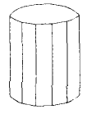
3D Object Representation
Graphics scenes can contain trees, flowers , clouds rocks water, rubber, paper , bricks etc.
Polygon and quadratic surfaces provide precise descriptions for simple Euclidean objects such as polyhedrons, ellipsoid.
Polygon Surfaces
3-D graphics object is a set of surface polygons that enclose the object interior
A polygon mesh is a set of connected polygonally bounded planar surfaces.
Equation of plane is Ax + By + Cz + D = 0
A polygon mesh is a collection of edges, vertices and polygons connected such that each edge is shared by at most two polygons.

Slide 2
Polygon Tables
Two types:
Attribute Table:
Includes parameters specifying the degree of transparency, surface reflectivity, texture characteristics, etc.
Geometric Table:
Vertex Table
Edge Table
Surface Table
Geometric data tables contain vertex coordinates and parameters to identify the spatial orientation of polygon surfaces

Slide 3
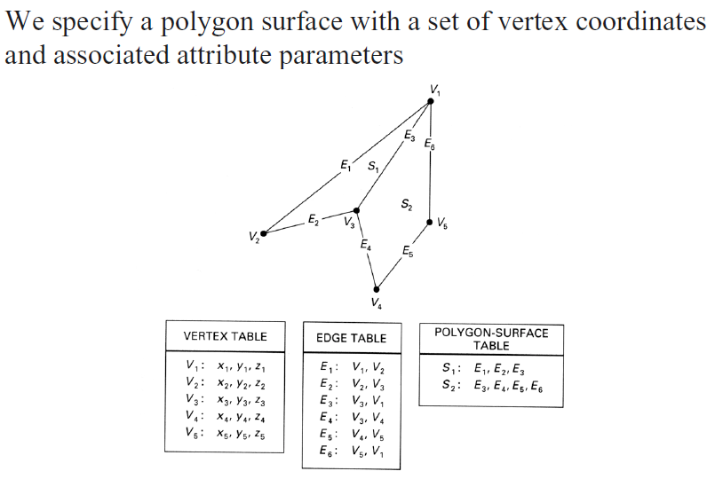
Polygon Tables

Slide 4
Plane Equations
The equation for a plane surface can be expressed as Ax + By + Cz + D =0 …….(i)
Where, (x,y,z) is any point on the plane- coefficients ABCD are constants describing the spatial properties of the plane
For solving ABCD consider three successive polygon vertices (x₁, y₁, z₁), (x₂, y₂, z₂), (x₃, y₃, z₃)
So equation (i) is modified to,
A x_{k} + B y_{k} + C z_{k} = -1 …….(ii)
D D D
Where k = 1,2,3

Slide 5
3D Object Representation
Plane equations are used to identify the position of spatial points relative to the plane surfaces of an object.
For any point (x,y,z) not on plane with parameters ABCD, we have
Ax + By + Cz + D = 0
We can identify the point as either inside or outside the plane surface according to the sign( + or -) of
Ax + By + Cz + D
If Ax + By + Cz + D < 0 then the point (x,y,z) is inside the surface
If Ax + By + Cz + D > 0 then the point (x,y,z) is outside the surface

Slide 6
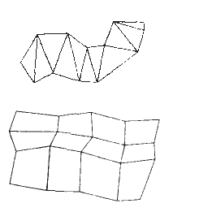
Polygon Meshes
Some graphics packages (PHIGS programmer’s Hierarchical Interactive Graphics Standard) provide several polygon functions for modeling objects.
One type of polygon mesh is the triangle strip
It produces n – 2 connected triangles, given the coordinates for n vertices.
Another similar functions the quadrilateral mesh that generates a mesh of (n-1)(m-1) quadrilaterals, given the coordinates for an n by m array of vertices

Slide 7
Visible Surface Detection/ Hidden Surface Removal
A major consideration in the generatation of realistic graphics is determining what is visible within a scene from a chosen viewing position
Algorithms to detect visible objects are referred to as visible-surface detection methods

Slide 8
Classification of Visible Surface Detection Algorithms
Object-space methods
Compares objects and parts of object to each other within the scene definition to determine which surfaces should be marked as visible
Image-space methods
Visibility is decided point by point at each pixel position

Slide 9
Back-Face Detection
A fast and simple object-space method for locating back faces
A point (x,y,z) is “inside” a polygon surface with plane parameters A, B, C, D if :
Ax + By + Cz + D < 0
When an inside point is along the line of sight to the surface, the polygon must be a back face and so cannot be seen

Slide 10
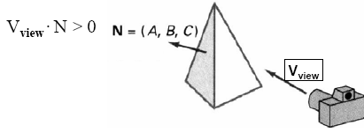

Back-Face Detection
The test is simplified by considering the normal vector N to the polygon and the viewing vector V
Visible surface if V.N<0
This is back face if V·N > 0
Partially hidden faces cannot be determined by back-face detection method

Slide 11
Depth Buffer Method
A commonly used image-space approach
Each surface is processed separately, one point at a time
Also called the z-buffer method
It is generally hardware implemented
The basic idea is to test the z-depth of each surface to determine the closest (visible) surface

Slide 12
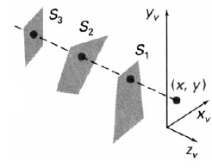
Depth Buffer Method
3 surfaces overlap at (x,y).
S₁ has the smallest depth value

Slide 13
Depth Buffer Method
Two buffers are needed
Depth buffer (distance information)
Frame buffer (intensity/color information)
OR
frame buffer : image value (intensity)
depth buffer (z-buffer) : z-value

Slide 14
Depth Buffer Method
Depth-Buffer Algorithm
for all (x,y)
depthBuff(x,y) = 1.0, frameBuff(x,y)=backgndcolor
for each polygon P
for each position (x,y) on polygon P
calculate depth z
if z < depthBuff(x,y) then
depthBuff(x,y) =z
frameBuff(x,y)=surfColor(x,y)

Slide 15
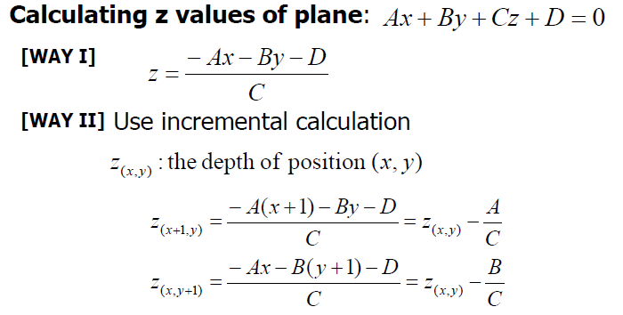
[WAY III]

Slide 16
Accumulation Buffer (A-Buffer)
An extension of the depth-buffer for dealing with anti-aliasing, area-averaging, transparency, and translucency
The depth-buffer method identifies only one visible surface at each pixel position : Cannot accumulate color values for more than one transparent and translucent surfaces.
Each position in the A-buffer has two fields
Depth field: Stores a depth value
Surface data field: RGB intensity components, Opacity parameter, Depth, Percent of area coverage, Surface identifier, etc.

Slide 17
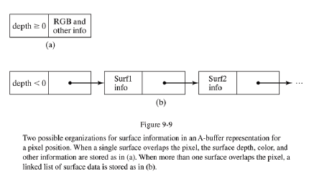
Accumulation Buffer (A-Buffer)

Slide 18
Scan-Line Method
Image space method
Extension of scan-line algorithm for polygon filling
As each scan line is processed, all polygon surface projections intersecting that line are examined to determine which are visible

Slide 19
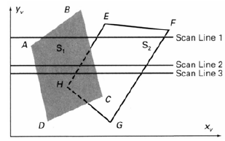
Scan-Line Method
Example

